Slide 1

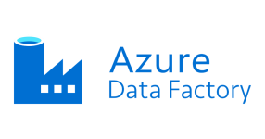
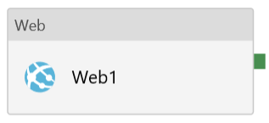
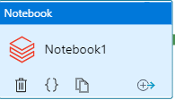



AZURE SPARK Automation
portal.azure.com
External Source
1
5
3
2
ADLS Gen2
4

Slide 2
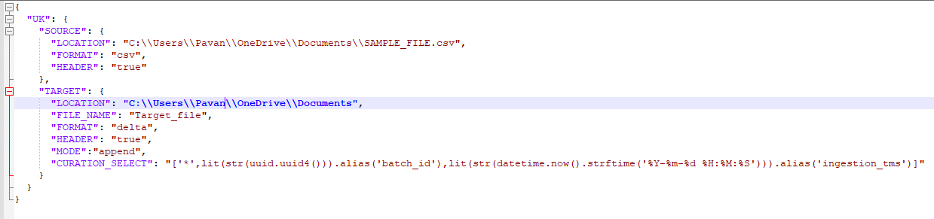
AZURE SPARK Automation
Assuming there is an external sources from which we need to pull data and they have provided api end point.
1
Fetching all the parameter details in a json file from adls location. such as below image will be store from where we will be fetching the details
2
3
Spark job inside databrciks will get the parameter file and web output from the activity.
4
Spark job will flatten the json file coming from web activity.
5
Store the data back to adls gen2.

